Slide 1
A Brief Introduction to Machine Learning -- Part I
Contact : Jun Song Wang(IBM Research China)

Slide 2
Outlines
Basic concept of machine learning
Support vector machine and linear regression
Loss function, regularization and optimizer (SGD)

Slide 3
Outlines
Basic concept of machine learning
Support vector machine and linear regression
Loss function, regularization and optimizer (SGD)

Slide 4
Machine Learning Applications
Compute Vision
Recommendation
Driverless Car
Web Search

Slide 5
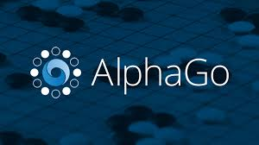

Machine Learning Applications
Speech Recognition
Question Answering
Game Player
Smart Heathcare

Slide 6
Supervised Learning and Unsupervised Learning
Supervised learning: Not only provide sets of raw data, but we also give the feature set required by the machine to easily classify different patterns.
eg. classification, regression
Unsupervised learning: Large sets of data that we give as an input to the machine to analyze, has not been labelled anyhow. The machine will see all the data and will itself find patterns.
eg. clustering, association analysis

Slide 7
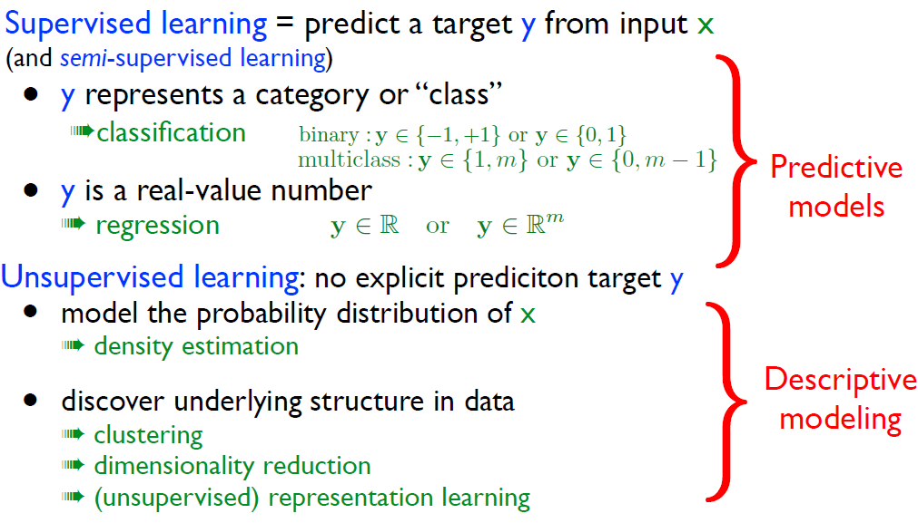
Machine learning tasks (problem types)
Training: we learn a predictive function fθ by optimizing
it so that it predicts well on the training set.
Use for prediction: we can then use fθ on new (test) inputs
that were not part of the training set.
The GOAL of learning is NOT to learn perfectly (memorize) the training set.
What’s important is the ability for the predictor to generalize well on new (future) cases.

Slide 8
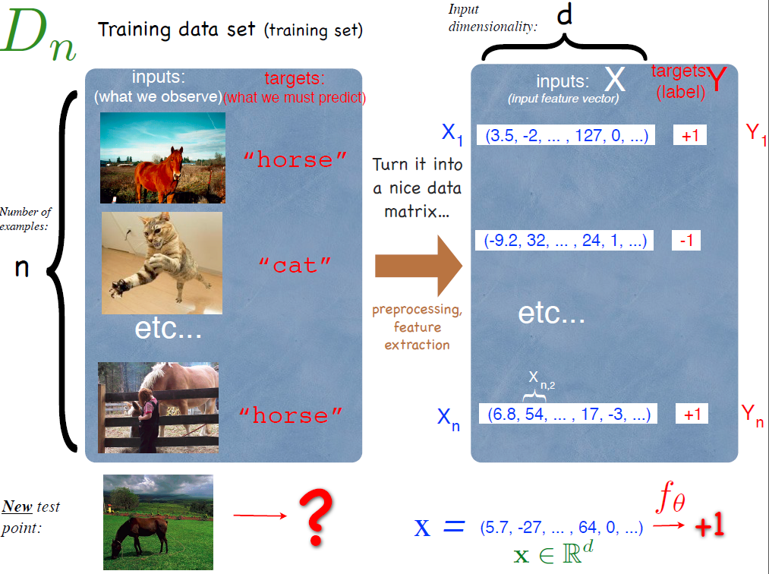
An example of supervised learning
Problem dimensions
• Number of examples: n
(sometimes several millions)
• Input dimensionality: d
number of input features characterizing each example
(often 100 to 1000, sometimes 10000 or much more)
• Target dimensionality ex. number of classes m
(often small, sometimes huge)

Slide 9
Turning an example into an input vector.
Raw input representation:
x = (0, 0, ..., 54, 120, ..., 0, 0) x = (125, 125, ..., 250, ...)
OR some preprocessed representation:
x = (, , , , ....)
Bag of words for «The cat jumped»: x = (... 0... ,0, 1, ...0... , 1, 0, 0, ...., 0, 0, 1, 0, ...0...)
OR vector of hand-engineered features: x = (feature 1, ... , feature d)

Slide 10
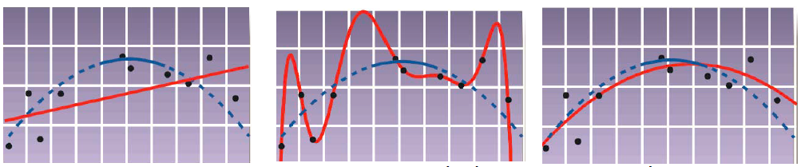
Under-fitting and Over-fitting.
capacity too low
➩under-fitting
capacity too high
➩over-fitting
optimal capacity
➩good generalization
performance on training set is not a good estimate of generalization.

Slide 11
Outlines
Basic concept of machine learning
Support vector machine and linear regression
Loss function, regularization and optimizer (SGD)

Slide 12
Two classical linear models
Support Vector Machines (SVM)
–支持向量机
Logistic Regression (LR)
–逻辑斯蒂回归
Which line is the best?

Slide 13
Support Vector Machines (SVM)
• A powerful method for 2-class classification
– Become very hot since late 90’s
• Better generalization
– less overfitting
• Key ideas
–Use kernel function to transform low dimensional training samples to higher dimensions
–Use quadratic programming (QP, 二次规划) to find the best classifier boundary hyperplane

Slide 14
Support Vector
Supported vectors are those datapoints that the margin pushes up against.

Slide 15
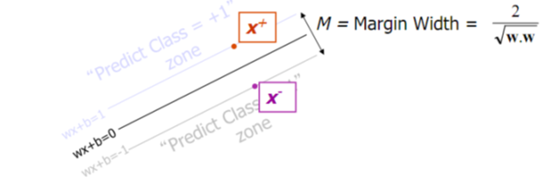
Maximum Margin Classifier
Given a guess of w and b:
Compute whether all data points in the correct half-planes
Compute the width of the margin
So we need to write a program to search the space of w and b to find the widest margin that matches all the data points. Quadratic Programming (QP)

Slide 16
Soft Margin Classification Mathematically

Slide 17
From Another View…

Slide 18
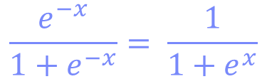
Logistic Regression (LR)
$$\frac{e^{−x}}{1+e^{−x}}= \frac{1}{1+e^{x}}$$

Slide 19
Logistic Regression (LR)

Slide 20
General Formulation of Linear Classifiers

Slide 21
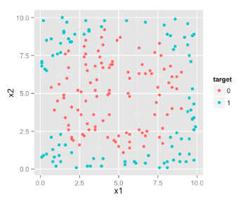
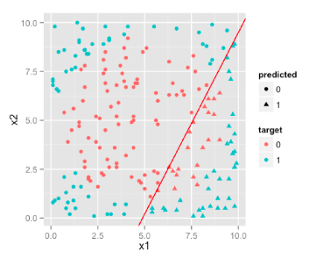
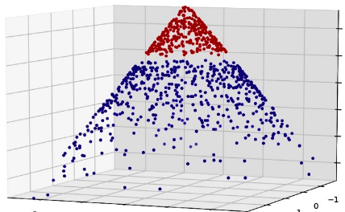
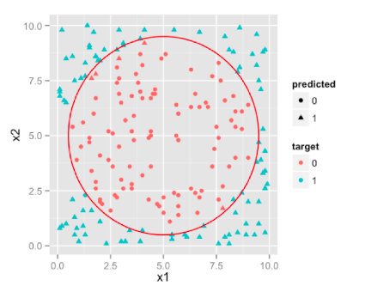
SVM Kernel
SVM works by projecting your feature space into kernel space and making the classes linearly separable.
An easier explanation to that process would be that SVM adds an extra dimension to your feature space in a way that makes classes linearly separable.
This planar decision boundary when projected back to original feature space emulates non linear decision boundary .

Slide 22
LR vs. SVM
Logistic Regression Pros:
Convenient probability scores for observations
Efficient implementations available across tools
Multi-collinearity is not really an issue and can be countered with L2 regularization to an extent
Wide spread industry comfort for logistic regression
Logistic Regression Cons:
Doesn’t perform well when feature space is too large
Doesn’t handle large number of categorical features/variables well
Relies on transformations for non-linear features
Relies on entire data [ Not a very serious drawback]
SVM Pros:
Can handle large feature space
Can handle non-linear feature interactions
Do not rely on entire data
SVM Cons:
Not very efficient with large number of observations
It can be tricky to find appropriate kernel sometimes
Always start with logistic regression, if nothing then to use the performance as baseline
Go for SVM if you have large number of features and number of observations are not a limitation for available resources and time

Slide 23
Outlines
Basic concept of machine learning
Support vector machine and linear regression
Loss function, regularization and optimizer (SGD)

Slide 24
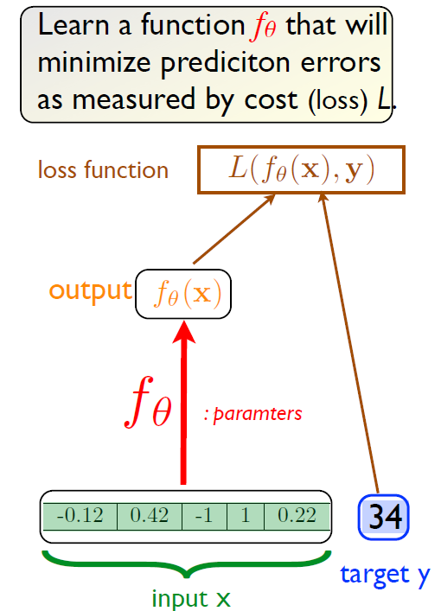
How to Design your own linear classifier.
Prepare the data set.
Define your learning function model.
Define the loss function and regularization.
Select the optimizer.
Train the model using the train data set.
Test/validate the model using the test/validation data set.

Slide 25
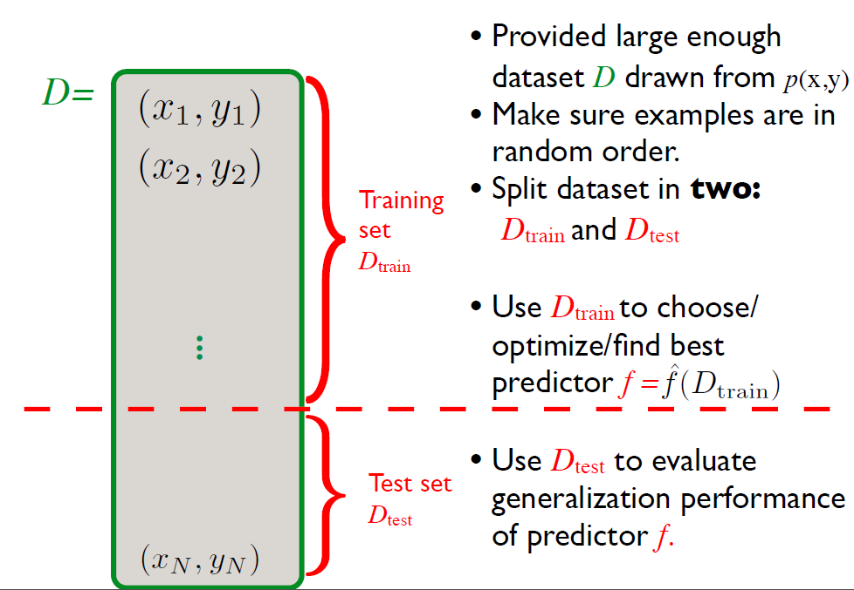
Simple train/test procedure

Slide 26
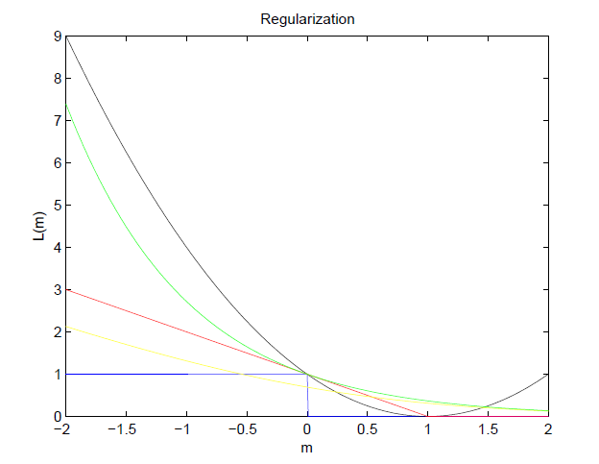
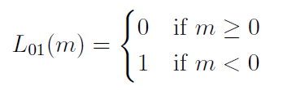
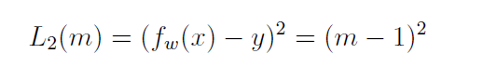
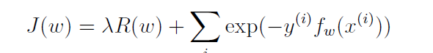
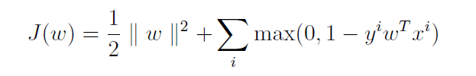
Loss Functions
Linear regression
boosting
SVM
the black line is for squared loss function, the red line is for Hinge loss, the yellow line is for logistic loss and the green line is for boosting loss.
LR

Slide 27
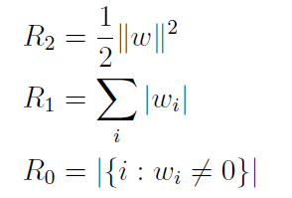
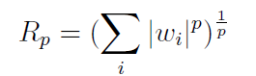
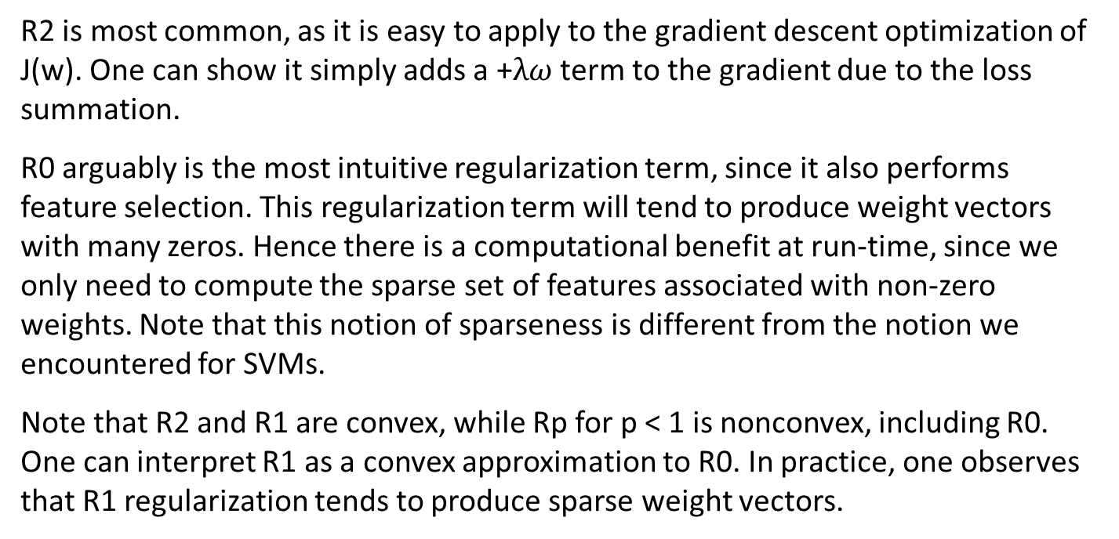
Regularization Term
R2 is most common, as it is easy to apply to the gradient descent optimization of J(w). One can show it simply adds a +$λω$ term to the gradient due to the loss summation.
R0 arguably is the most intuitive regularization term, since it also performs feature selection. This regularization term will tend to produce weight vectors with many zeros. Hence there is a computational benefit at run-time, since we only need to compute the sparse set of features associated with non-zero weights. Note that this notion of sparseness is different from the notion we encountered for SVMs.
Note that R2 and R1 are convex, while Rp for p < 1 is nonconvex, including R0. One can interpret R1 as a convex approximation to R0. In practice, one observes that R1 regularization tends to produce sparse weight vectors.

Slide 28
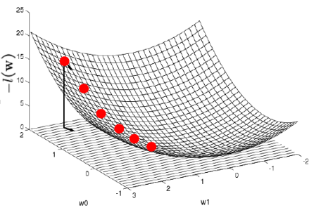
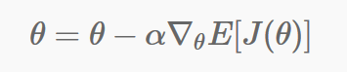
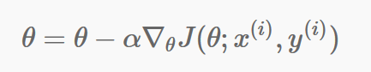
Optimizer: Stochastic Gradient Descent (SGD)
The standard gradient descent algorithm updates the parameters θ of the objective J(θ) as,
where the expectation is approximated by evaluating the cost and gradient over the full training set.
Stochastic Gradient Descent simply does away with the expectation in the update and computes the gradient of the parameters using only a single or a few training examples.
Generally each parameter update in SGD is computed by a few training examples or a minibatch as opposed to a single example. The reason for this is twofold:
This reduces the variance in the parameter update and can lead to more stable convergence.
This allows the computation to take advantage of highly optimized matrix operations that should be used in a well vectorized computation of the cost and gradient. A typical minibatch size is 256, although the optimal size of the minibatch can vary for different applications and architectures.

Slide 29
References
http://ufldl.stanford.edu/tutorial/supervised/OptimizationStochasticGradientDescent/
http://www.edvancer.in/logistic-regression-vs-decision-trees-vs-svm-part1/
http://www.edvancer.in/logistic-regression-vs-decision-trees-vs-svm-part2/
DeepLearningSummerSchool2015, Vincent, machine learning

